Slide 1
Algorithm Analysis
By Alex Somwaru

Slide 2
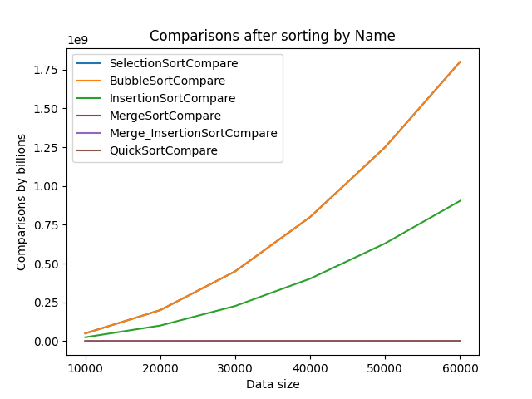
Criteria 1 comparisons
Throughout the different criteria, selection sort and bubble sort have the same comparisons and copies.
Merge, Merge Insertion, and Quick sort all work so efficiently compared to the selection and bubble sort that it is hard to see the comparisons of those functions.

Slide 3
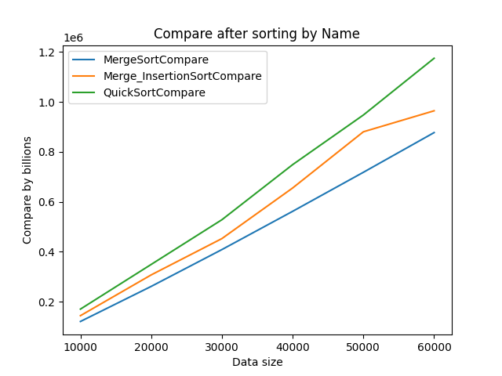
A closer look at the other three functions
Merge sort seems to be almost linear in its comparisons.
In general, Quick Sort will have more comparisons than Merge sort.
Merge Insertion sort seems to do more comparisons than regular merge sort.

Slide 4
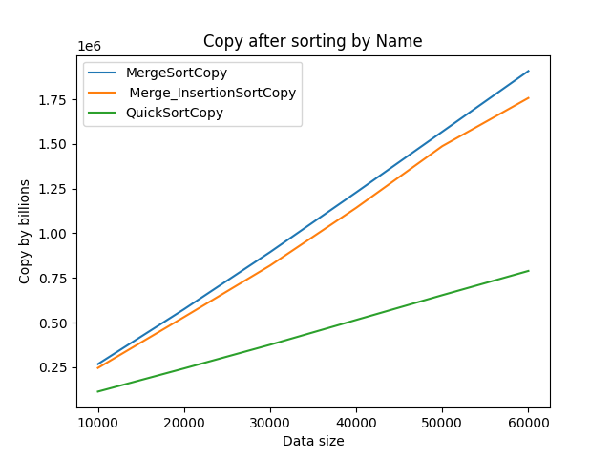
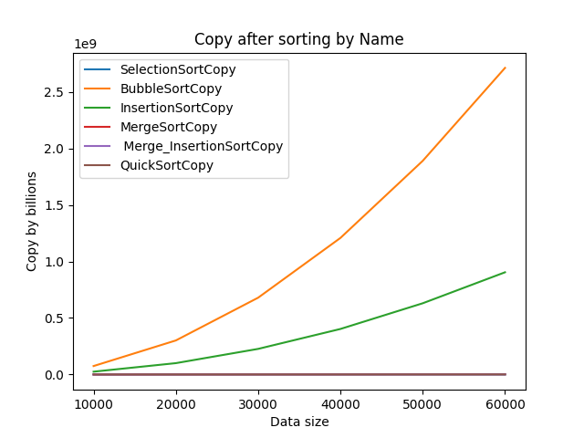
Criteria 1 copies
Like all the other figures, Bubble sort has the most copies whereas Merge, Merge Insert, and Quick sort have miniscule copies in comparison.
While Quick sort has more comparisons, it has far less copies than Merge and Merge Insert

Slide 5
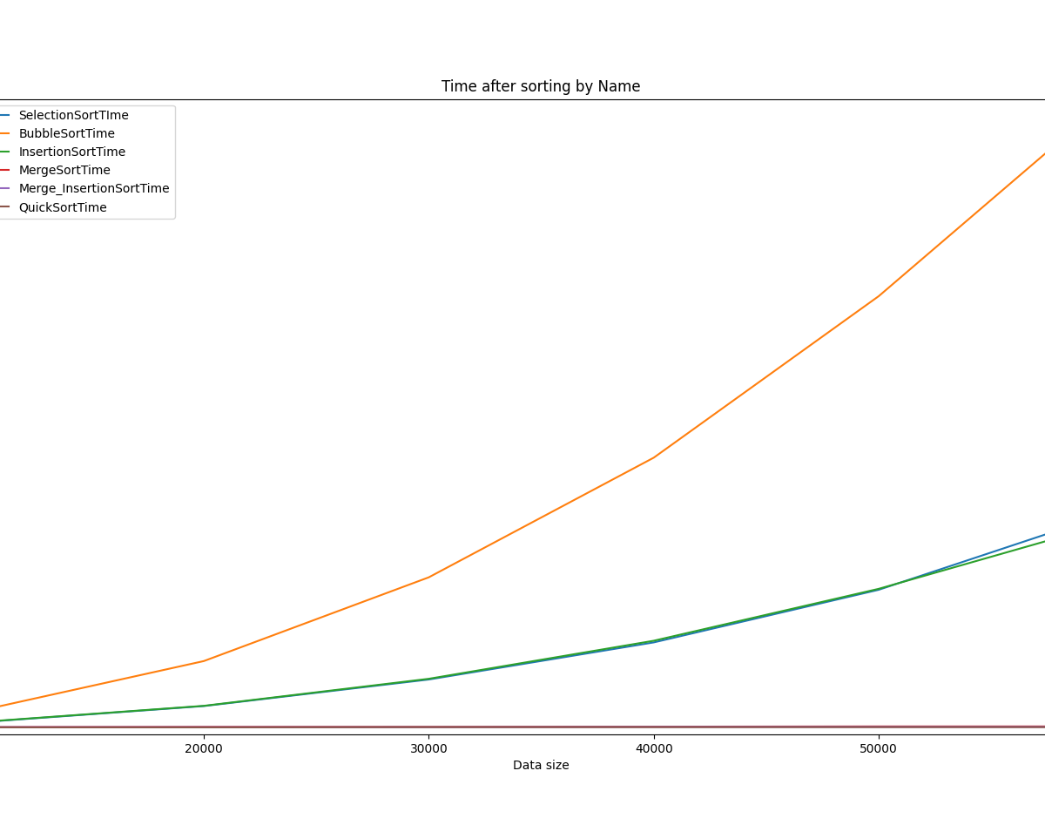
Criteria 1 Runtime
This time, Bubble sort takes the longest to run while Insertion and Selection take about the same time.

Slide 6
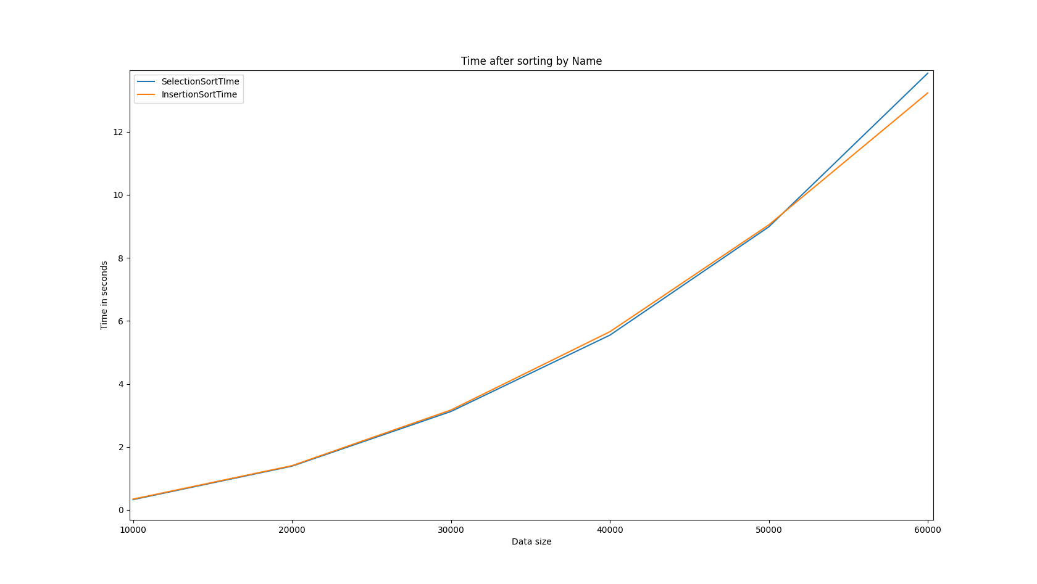
Criteria 1 Selection vs Insertion Time

Slide 7
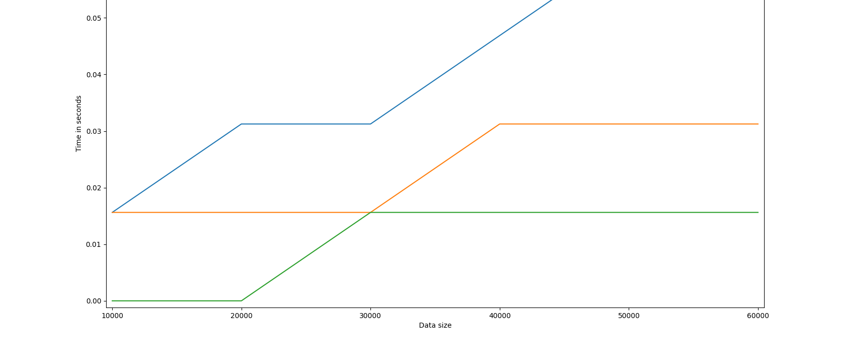
A closer look at the other three functions

Slide 8
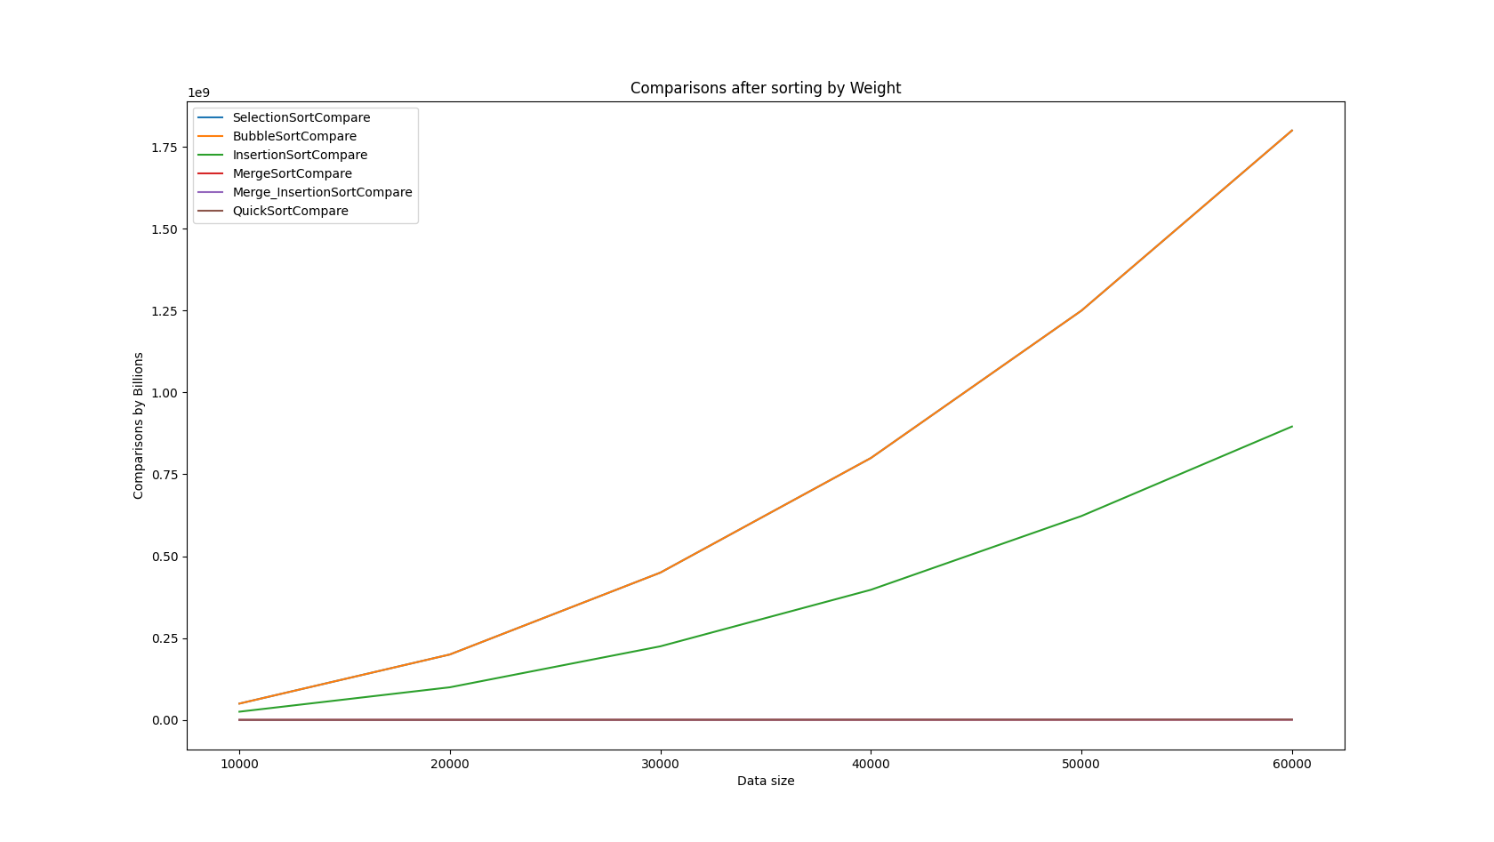
Criteria 2 – Comparisons of sorting by Weight

Slide 9
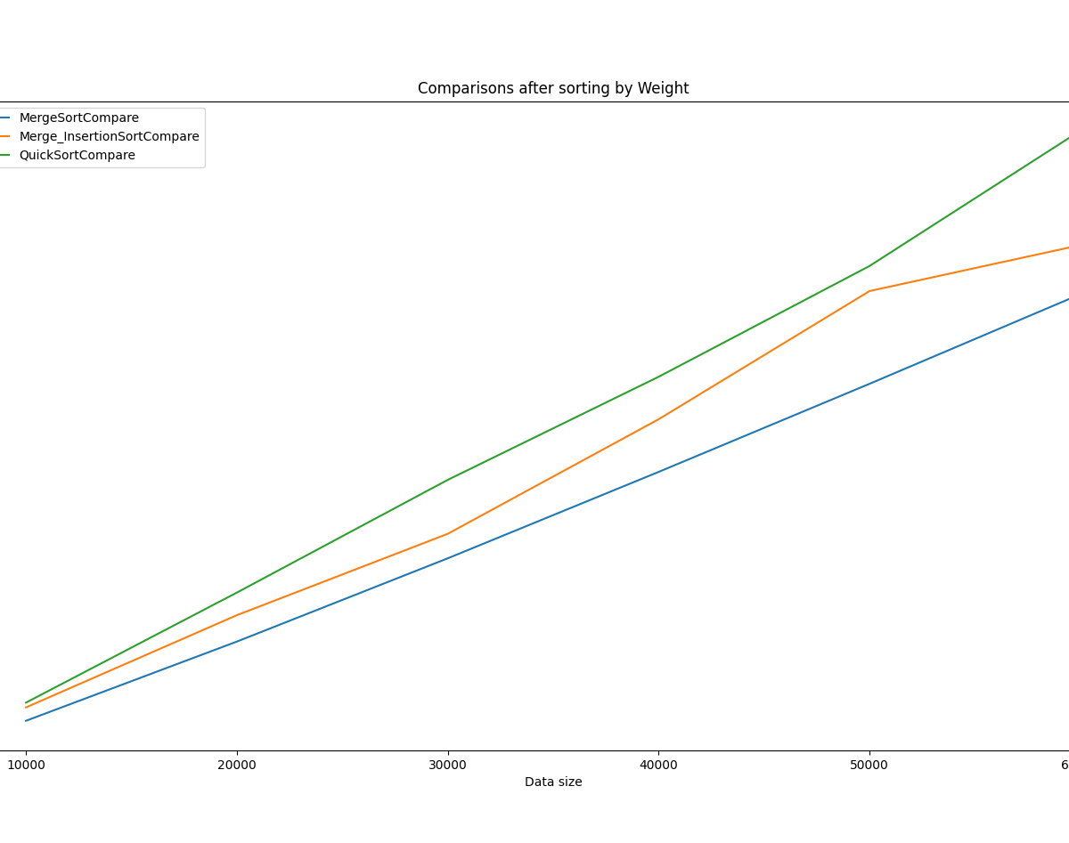
Comparisons of the faster functions
Like in the last section, Quick sort has the most comparisons of the three.
Merge Insertion also does not have a better rate of comparison compared to regular merge sort.

Slide 10
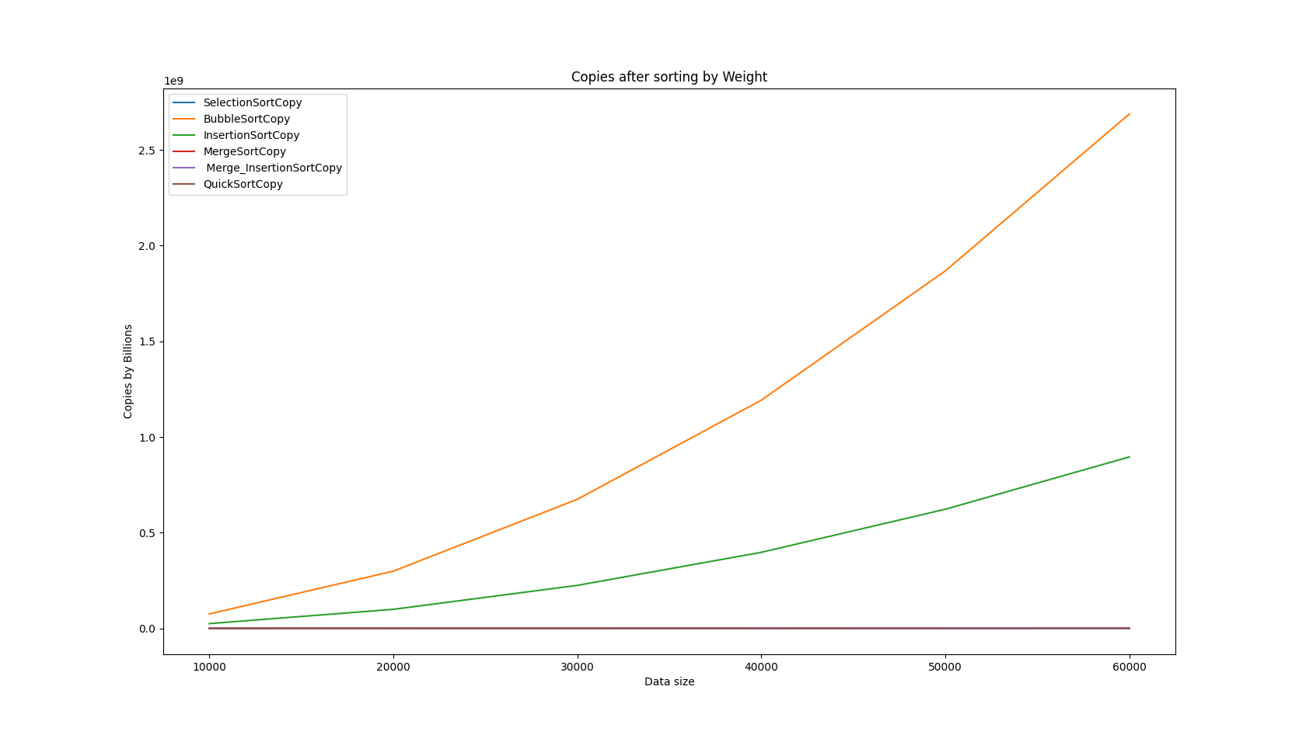
Criteria – Copy of sorting by Weight

Slide 11
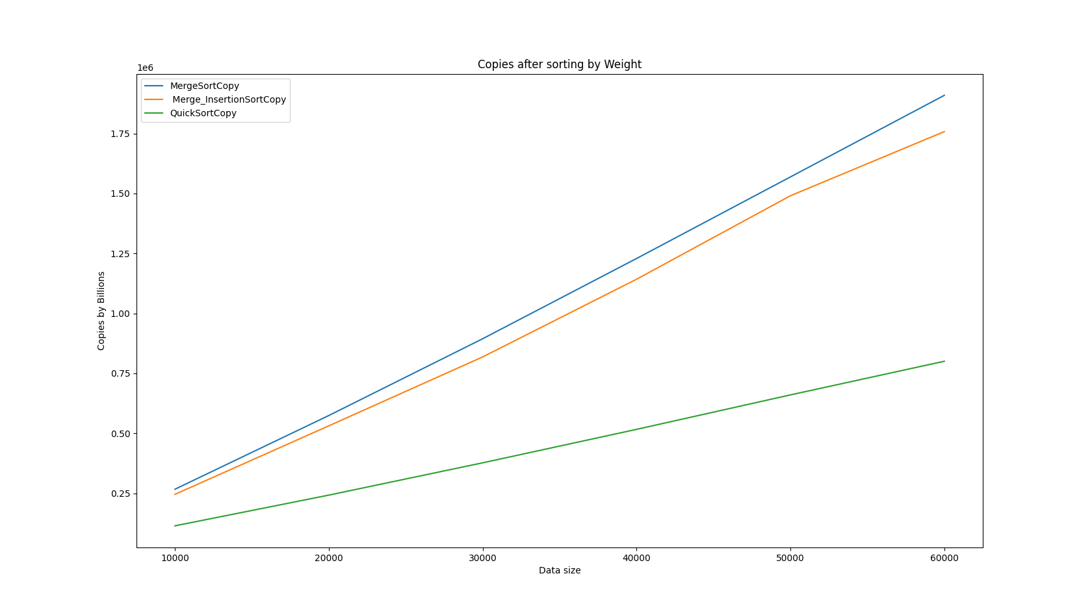
Criteria 2 - Copies (Cont’d)

Slide 12
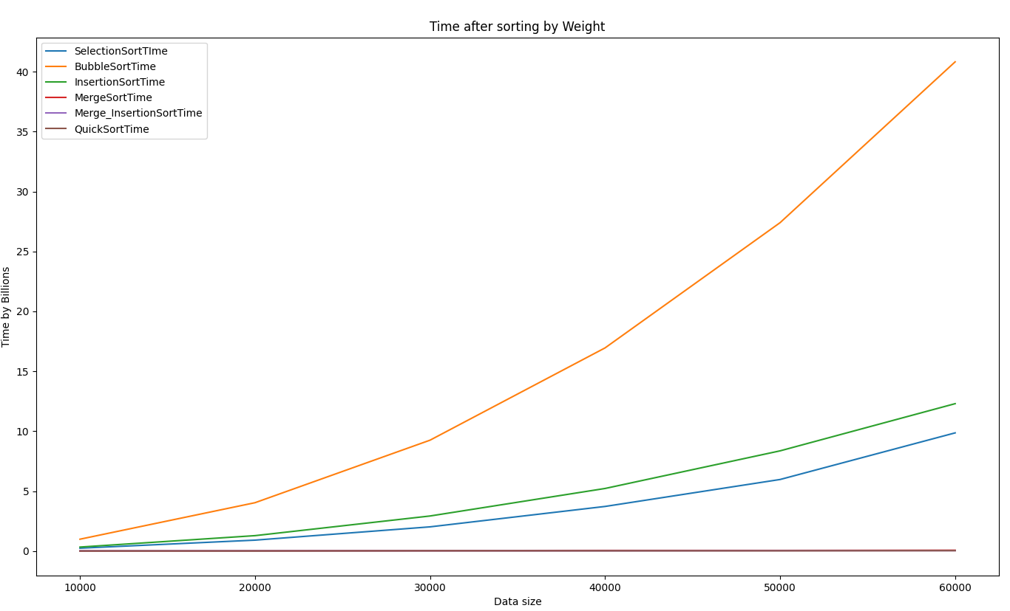
Runtime of Criteria 2
As always, bubble sort has the worst runtime, but selection sort has some better speed compared to criteria 1.

Slide 13
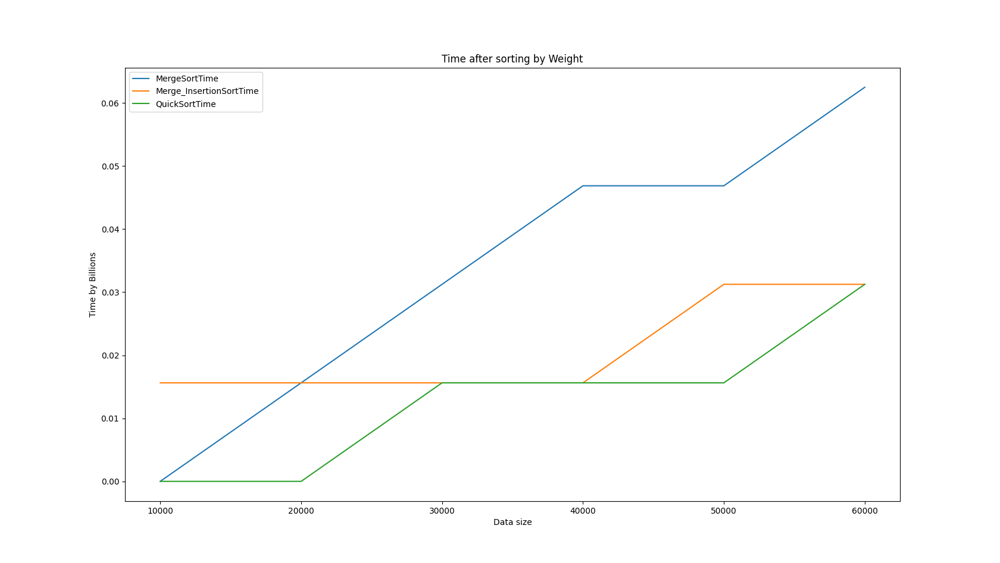
Criteria 2 – Runtime (cont’d)

Slide 14

Criteria 3 – Sorting by name and then weight
Criteria 3 follows the same trends as the other criteria.

Slide 15
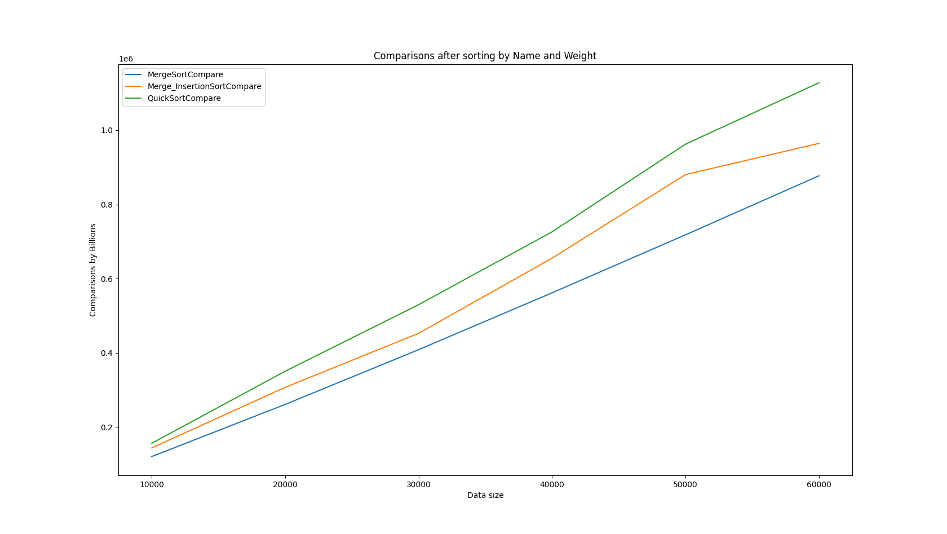
Criteria 3 – faster functions

Slide 16
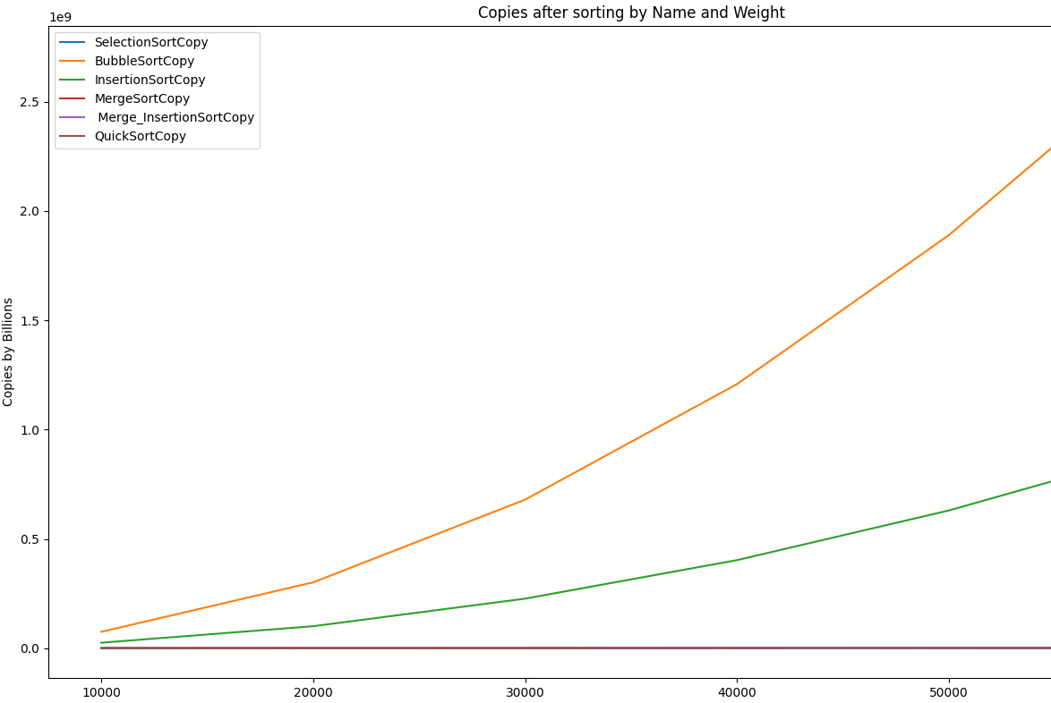
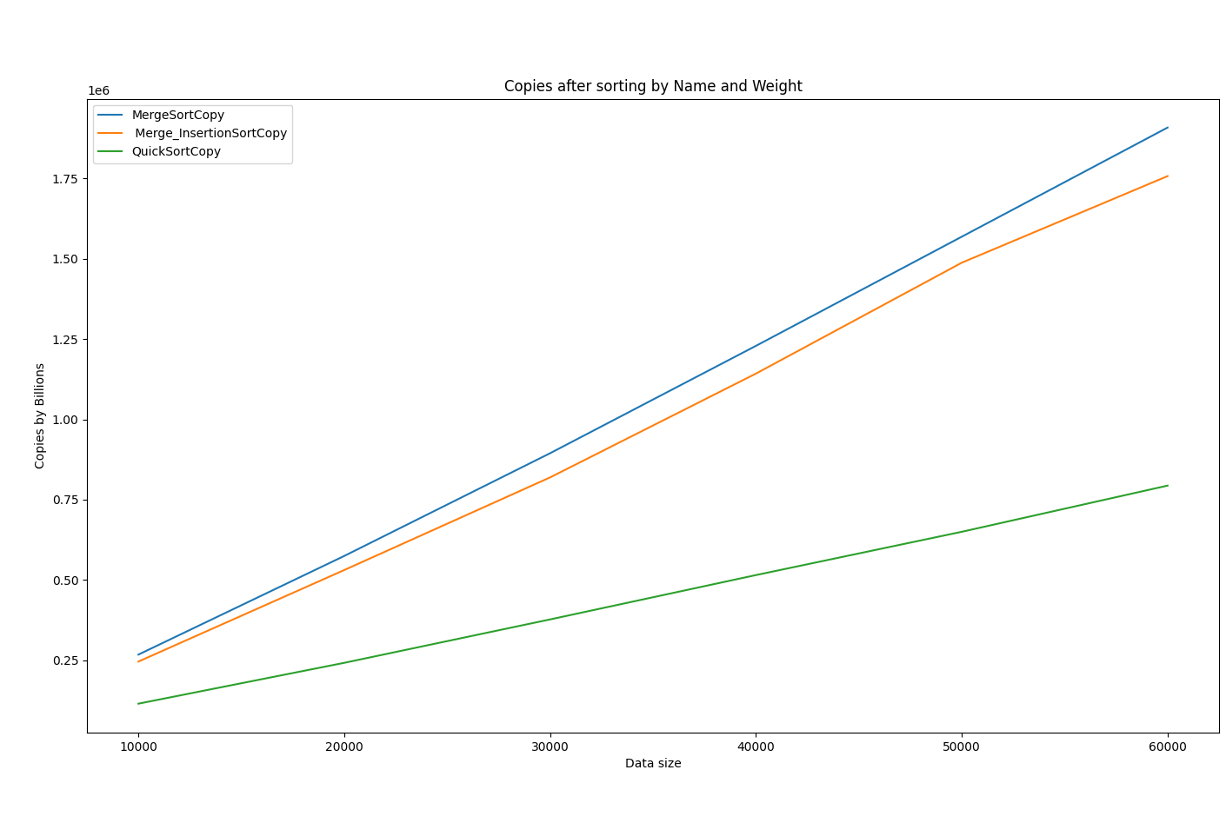
Criteria 3 – copies

Slide 17
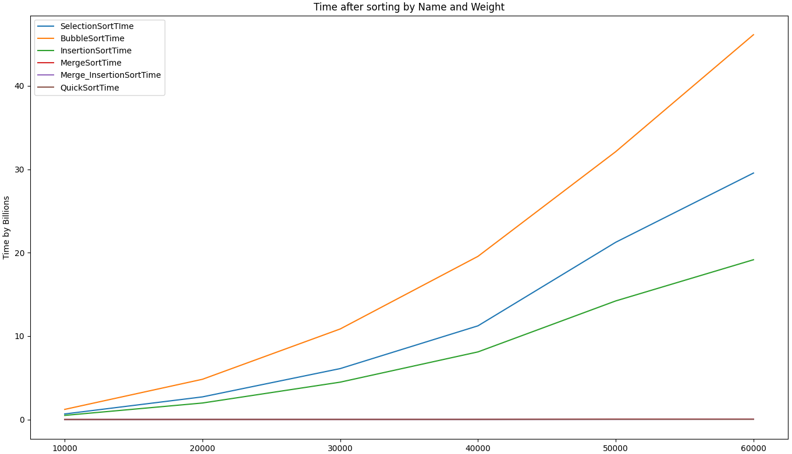
Criteria 3 – Runtime
Interestingly, selection sort took longer than insertion sort. Which was not the case of the other 2 criteria.

Slide 18
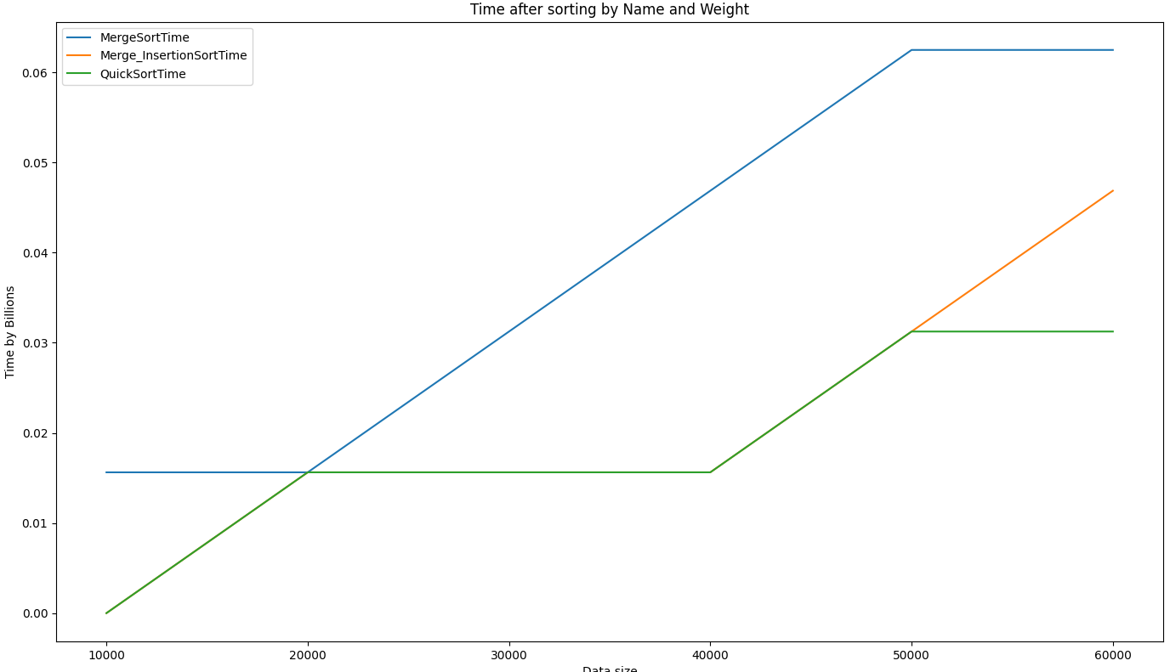
Criteria 3 – Runtime continued

Slide 19
Summary
Throughout the three criteria, the sorting algorithms all followed the same trends.
The only special case were runtime where some of the functions would run faster than others.
Quick, Merge, and Merge Insertion sort all were highly consistent in speed and efficiency. Unlike bubble, selection, and insertion sort.

